Slide 1
EECE 528
Virtual Memory
Instructor: Guy Lemieux
lemieux@ece.ubc.ca
(many slides courtesy of Dr. Tor M. Aamodt)

Slide 2
Multitasking
Most OS’s multitask
  Run Program A and B at the same time
Most CPUs must support multitasking
  Not run at exactly the same time:
    Run Program A for 20ms
    Run Program B for 20ms
    Run Program A for 20ms, etc
Multitasking involves providing short “time slices” to programs
NOTE: Multitasking is different than “hardware multithreading”

Slide 3
Multiple Programs Using Memory
Computer has 1024 MB DRAM
  Internet Explorer (IE) uses 30 MB
  MS Word uses 20 MB
  Windows uses 1280 MB
  Total: 1330 MB
How to run all three programs at once?
It gets worse….
  Firefox assumes memory starts at address 0
  Word assumes memory starts at address 0
    How can they both run if they both assume memory starts at 0 ??
  Windows? It’s the OS…. who knows!

Slide 4
Multiple Programs Using Memory
Word
It gets even worse
  Windows starts using 1280 MB
  IE starts using 30 MB
  Word starts using 20 MB
  User opens web page (cnn.com), IE wants + 72MB
  User opens document (ps3 soln) Word wants +30MB
  User opens 2nd web page(youtube), IE wants +40MB
  User edits document, Word wants +10MB
  TOTAL
    Windows 1280MB, IE 142 MB, Word 60 MB
IE
Main
Mem
Word
IE
Word
IE
Windows

Slide 5
How can we divide up memory between programs?
It gets even worse
  Exit Word
  Start engineering program
    Wants 300MB for a matrix
    Must be contiguous!
    How?
    Move IE? Not realistic
Solution?
  Divide Main Memory into pages, say 4KB each
  Divide Programs into pages (same size)
  Map Program Pages into Main Memory Pages
  If Main Memory full, some Program Pages on disk
IE
Main
Mem
IE
IE
Vista

Slide 6
Solution: Virtual Memory
IE sees this
Main Memory sees this
V
i
r
t
u
a
l
a
d
d
r
e
s
s
e
s
P
h
y
s
i
c
a
l
a
d
d
r
e
s
s
e
s
A
d
d
r
e
s
s
t
r
a
n
s
l
a
t
i
o
n
IE
IE
IE
Pages
IE
IE
IE
IE
IE
IE
Fragmented:
Non-contiguous (holes),
out-of-order,
some on disk
Can store some on disk!
D
i
s
k
a
d
d
r
e
s
s
e
s

Slide 7
Address Translation
Software uses virtual addresses
Page Size:
2^12 = 4096 bytes
V
i
r
t
u
a
l
a
d
d
r
e
s
s
3
1
3
0
2
9
2
8
2
7
1
5
1
4
1
3
1
2
1
1
1
0
9
8
3
2
1
0
V
i
r
t
u
a
l
p
a
g
e
n
u
m
b
e
r
P
a
g
e
o
f
f
s
e
t
Address
Translation
Table Lookup
T
r
a
n
s
l
a
t
i
o
n
2
9
2
8
2
7
1
5
1
4
1
3
1
2
1
1
1
0
9
8
3
2
1
0
P
h
y
s
i
c
a
l
p
a
g
e
n
u
m
b
e
r
P
a
g
e
o
f
f
s
e
t
P
h
y
s
i
c
a
l
a
d
d
r
e
s
s
Hardware uses physical addresses

Slide 8
Virtual Memory
Program Viewpoint
  Addresses start at 0
  There is always lots of free memory available
  Single Malloc() call gives program contiguous memory (consecutive addresses)
  Malloc(), Free(), Malloc(), Free()
    Can malloc() re-use parts that are freed?
    Causes internal fragmentation within one program

Slide 9
Virtual Memory
CPU/OS Viewpoint
  Keep all programs separate
    Don’t all start at 0
    Security implications…. programs should not read each other’s data!
  Dynamic program behavior cause memory fragmentation
    Starting & ending programs, swapping to disk
    Causes external fragmentation between programs
  When program asks for memory with malloc(), the physical memory was previously used by another application
    What should the OS do?
  Limited memory available
    Use Disk to hold extra data
    Use Main Memory like a cache for the program data stored on disk
Solution? New structure: Page Table

Slide 10
Page Table: Big Lookup Table
Firefox sees this
Main Memory sees this
Virtual Addresses
Physical Addresses
Address
Translation
IE
IE
Pages
IE
IE
IE
IE
IE
IE
IE
Fragmented:
Non-contiguous (holes),
out-of-order,
some on disk
Page Table
D
i
s
k
a
d
d
r
e
s
s
e
s

Slide 11
Page Table
Holds virtual-to-physical address translations
Access like a memory
  Input: Virtual Address
    Only need Virtual PageNumber portion (upper bits)
    Lower bits are PageOffset, ie which byte inside the page
  Output: Physical Address
    Lookup gives a Physical PageNumber
    Combine with PageOffset to form entire Physical Address
Where to hold the PageTable for a program?
  Dedicated memory inside CPU? Too big! not done!
  Instead, store it in main memory

Slide 12
Page Table Translation Structure
Page Table Register
Virtual Address
Size of
Page Table?
2^20 or
~1 million
entries
1 Page Table
Per Program
3
1
3
0
2
9
2
8
2
7
1
5
1
4
1
3
1
2
1
1
1
0
9
8
3
2
1
0
Virtual Page Number
Page Offset
2
0
1
2
Valid
Physical Page Number
Page
Table
If 0 then page
is on disk
1
8
2
9
2
8
2
7
1
5
1
4
1
3
1
2
1
1
1
0
9
8
3
2
1
0
Physical Page Number
Page Offset
Physical Address

Slide 13
Page Table Implications
CPU executes “Load” instruction
  Recall: address is now a Virtual Address
  First step: Lookup address translation
    Where is page table? In main memory
    Special CPU register called Page Table Register (PTR)
      Holds starting address of page table
    Read DataMem from PTR+PageNumber to get Physical Address
  Second step: Access the data
    Read DataMem from Physical Address
Every load/store requires TWO memory accesses
  Slow!
  Can we speed up the translation step? Yes, use a cache!

Slide 14
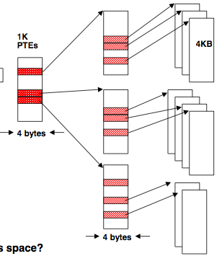
Page tables may not fit in memory!
A table for 4KB pages for a 32-bit address space has 1M entries
Each process needs its own address space!
Two-level Page Tables
32 bit virtual address
31
22
21
12
11
0
P1 index
P2 index
Page Offset
Top-level table wired in main memory
Subset of 1024 second-level tables in main memory; rest are on disk or unallocated

Slide 15
TLB: Translation Looksaside Buffer
(A special cache for the Page Table)
V
i
r
t
u
a
l
p
a
g
e
Physical Page
Number
n
u
m
b
e
r
V
Tag
TLB
1
Physical Memory
1
1
1
0
1
Physical Page Number
or Disk Address
V
1
1
Disk
1
1
0
1
Page
Table
1
0
1
1
0
1

Slide 16
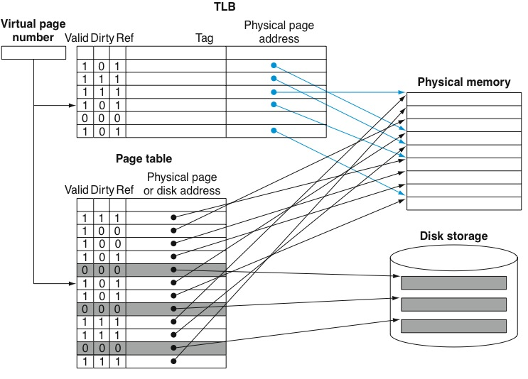
What about writes? How to determine what to put on disk?

Slide 17
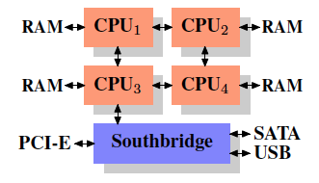
Multiprocessor Implications
Application sees contiguous memory using virtual addresses, starting at address 0
Physically broken up into pages (4kB)
  Distributed across different physical locations
  NUMA = non-uniform memory access time
  Need to control where each page is located

Slide 18
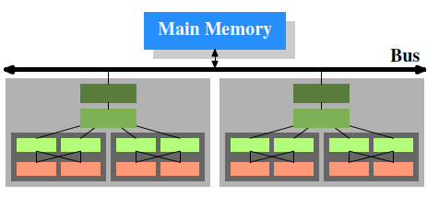
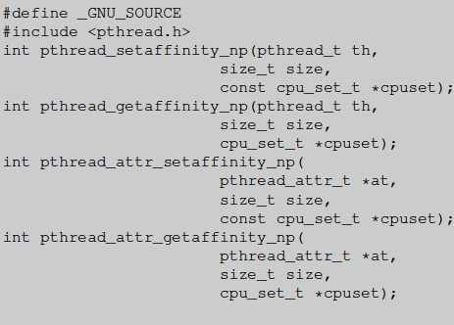
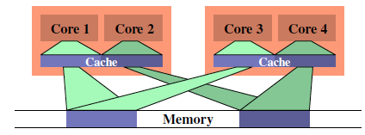
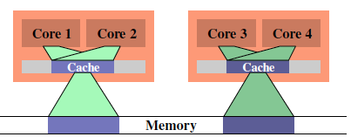
CPU Affinity
Affinity
  Which process runs on which CPU
  Process stays on same CPU (maintain cache history)
  Also, if process moves ➔ contention, or distant memory

Slide 19
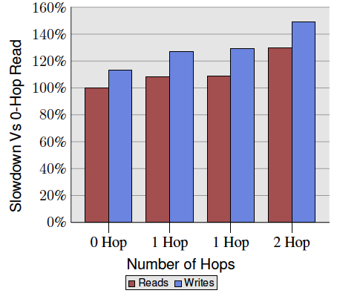
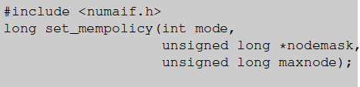
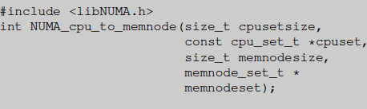
NUMA Programming
NUMA = non-uniform memory access (time)
  “close” memory = faster, “far” memory = slower
  “Memory policy” controls where pages are located when allocated

